Slide 1
Ponds in Benson
Photo: freshwaterhabitats.org.uk
A survey was made in April 2007 of garden ponds and their contents.
Short questionnaire inserted in Benson Bulletin, with more detailed form if requested.

Slide 2
Benson Pond Survey
Do you have a pond in your garden? Yes No
Does it contain fish? Yes No
Do frogs live in it, or lay spawn? Yes No
Your postcode:
Your name:
Number/name of house:
Street in Benson:
If you are willing to fill in a more detailed questionnaire, please indicate here and one will be delivered to you. Yes No

Slide 3
Pond survey results
59 forms returned, 46 with a pond, 13 without
Widely scattered around the village
14 ornamental ponds, 12 for wildlife, others for both
Sizes from 20” diameter to 10ft x 12ft
41 people requested a detailed form for organisation “Pond Conservation”

Slide 4
Pond survey results
63% contained fish
Frogs and spawn seen in 87%
Newts seen in 26%
4 reports of grass snakes
Many had dragonflies or damselflies
Many used by birds for bathing and drinking

Slide 5
Pond survey conclusions
Only very new or very small ponds did not have frogs
Frogs co-habit happily with fish
All 12 ponds with newts also had frogs
Having fish does not discourage newts
No special hotspots for newts in village

Slide 6
Pond survey conclusions
Newts do not spread into village from one particular field pond
Frogs do not put newts off from arriving
Frog tadpoles and fish do not eat all newt eggs
Garden ponds make a major contribution to wildlife

Slide 7
Frogs
Photo: Sam Taylor (froglife.org)
Observations of frogs in a 12ft x 8ft pond in St Helen’s Crescent, Benson over 13 years

Slide 8
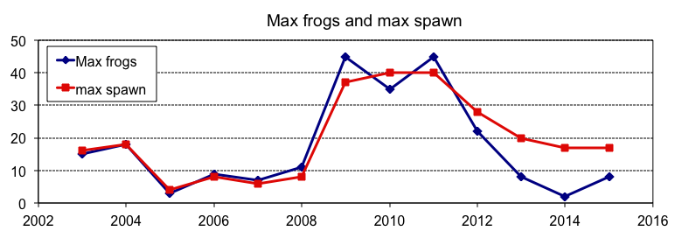
Frogs
Maximum no. of frogs seen at one time, and final no. of clumps of spawn laid
In most years, there is a “frog day” when large numbers arrive early morning
Mainly males (grey throats) waiting for females (orange throats) to arrive
Smaller numbers are seen over a period of 2 to 5 weeks
Maximum number varies widely from 2 to 45, in no obvious pattern
The no. of clumps of spawn follows the max no. of frogs quite closely
Much greater numbers of both appeared 2009 – 2012: don’t know why!

Slide 9
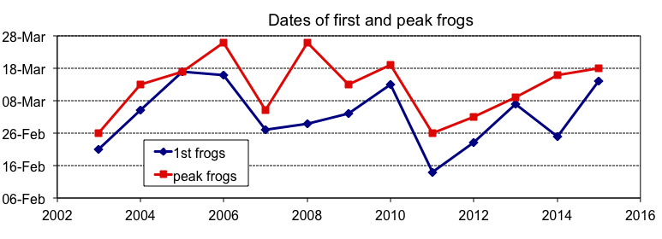
Frogs
Date first frog seen in pond, and
date of “peak frogs”
Date of first frog varies between 14th February and 17th March
Date of peak frogs varies between 26th February and 26th March
No obvious pattern to dates (I haven’t correlated with weather)
No evident trend due to climate change over 13 years
The years with larger peak frog numbers do not correlate with the dates
These are results from just one pond so not statistically robust
Why not make similar observations yourself if you have an easily visible pond?

